Slide 1
ASSESSING SNAKE-HUMAN CONFLICT IN KIBERA
Radhia Khamis Ramadhan
J42/4362/2020
Supervisor: Dr. Titus Ndiwa

Slide 2
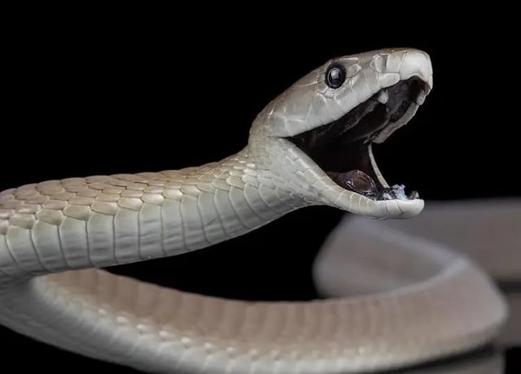

Slide 3
Snakebite is a WHO-listed Neglected Tropical Disease that kills 32,000 people residing in some of the most disadvantaged rural communities of sub-Saharan Africa and leaves over 90,000 surviving victims with permanent physical disabilities / disfigurements.
https://ksric-asrg.org/
Kenya SnakeBite and Intervention Centre

Slide 4
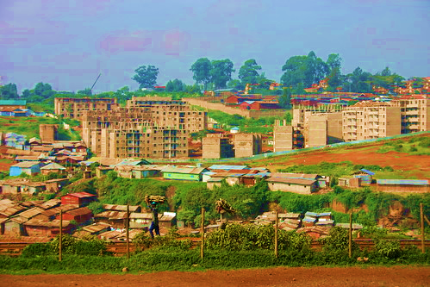
BACKGROUND INFORMATION
Kibera as a place
This Photo by Unknown Author is licensed under

Slide 5
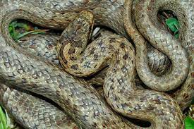
THE STUDY SPECIES/ SUBJECTS OR PARTICIPANTS
-Residents in Kibera
- Snakes
Assailant and Vitim
Puff Adder

Slide 6
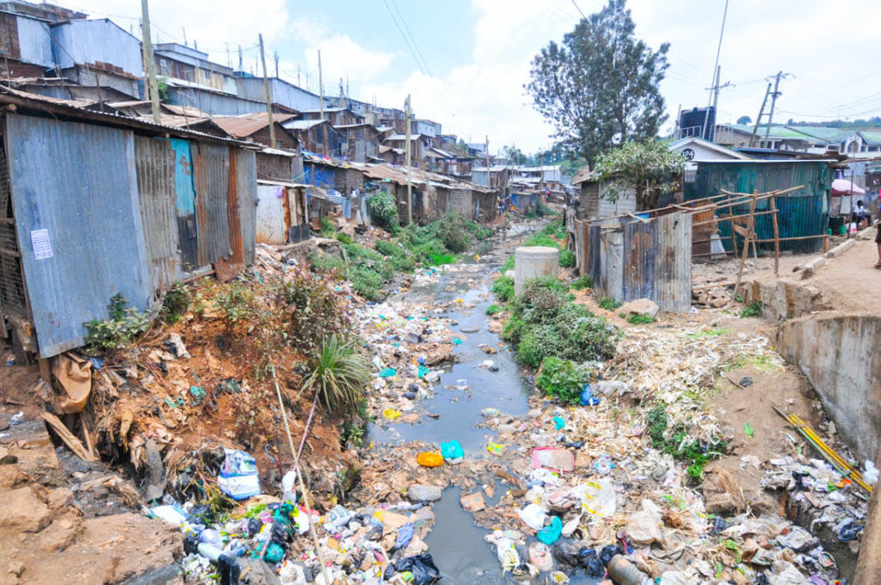
vegetation
Untreated river water turned sewage
Piled up trash

Slide 7
PROBLEM STATEMENT
Increased snake bites in Kibera leading to killings of snakes on sight and destruction of habitats.
Harmonious cohabitation of snakes and human beings.
Exploration of understudied urban wildlife interactions.

Slide 8
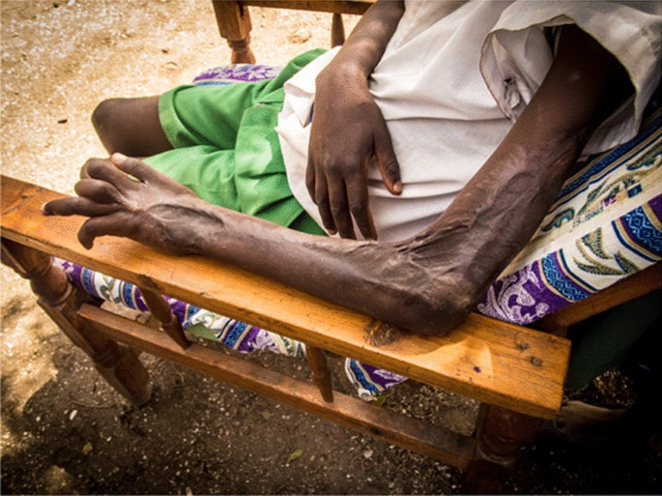
Snake bite effect

Slide 9
OBJECTIVES
General objectives
Assessing different perceptions of snakes among various demographic groups in Kibera and determining the main factors contributing to human-snake conflicts in urban areas i.e. Kibera
Specific objectives
Assessing different perceptions of snakes among different demographic groups in Kibera
Determining main factors contributing to human snake conflicts in urban areas i.e. Kibera

Slide 10
RESEARCH QUESTION
How do perceptions of snakes vary among different demographic groups in Kibera?
What are the main factors contributing to human snake conflicts in urban areas like Kibera?

Slide 11
LITERATURE REVIEW
Impact on Community and Health
Human-snake conflicts pose health risks, particularly due to snake bites, leading to morbidity and mortality {Kasturiratne et al,2008}.
Role of Cultural Beliefs
Cultural beliefs influence community perceptions and behaviors toward snakes, contributing to conflicts {Sawchuk et al, 2018}.

Slide 12
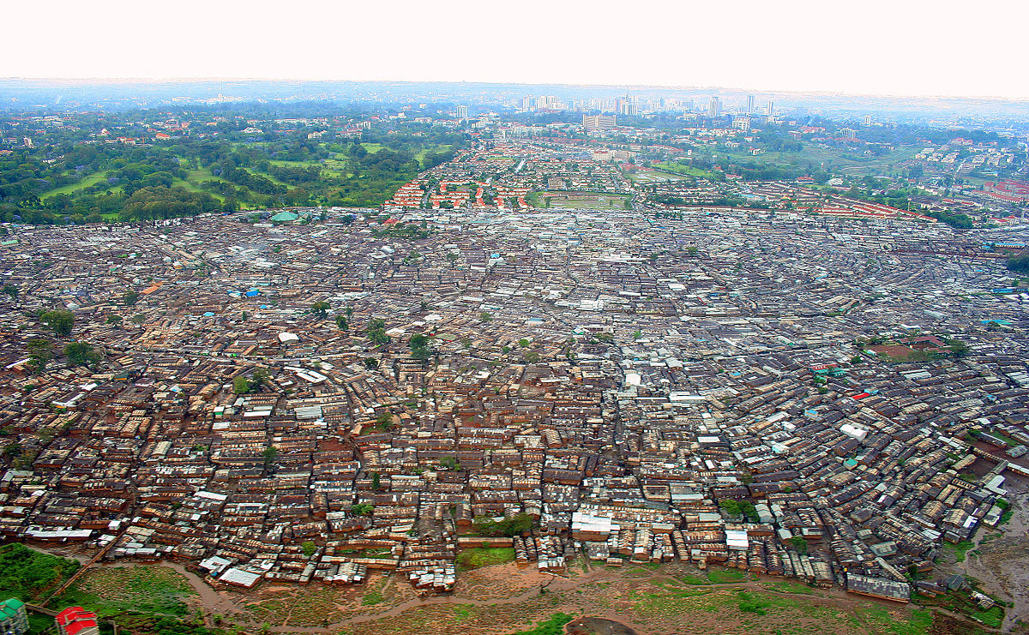
STUDY AREA
This Photo by Unknown Author is licensed under
Figure 1. Map showing study area in Kibera, Kenya

Slide 13
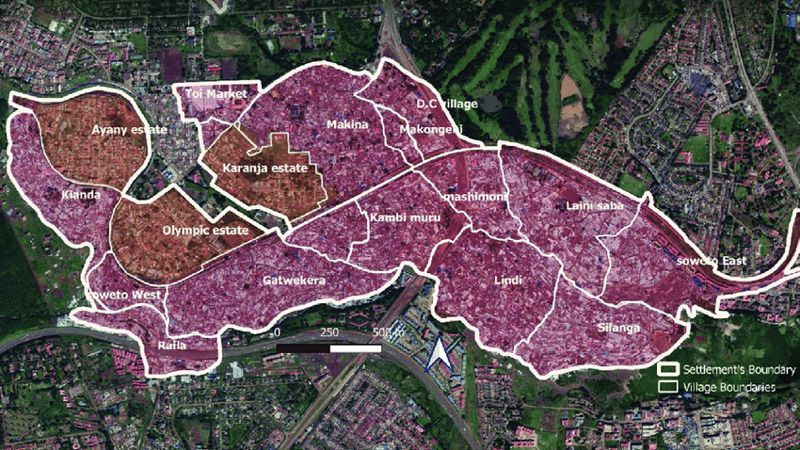
V

Slide 14
METHODOLOGY
Determining the extent of human-snake conflicts in Kibera.
Questionnaire to a sample of hospitals
Literature review on documented instances
Identifying different factors contributing to human-snake conflicts in Kibera.
Sampling
Observation{ Picture and video}

Slide 15
DATA ANALYSIS
Data will be analyzed using Descriptive statistics i.e. Distribution

Slide 16
REFERENCES
Kasturiratne, A., Wickremasinghe, A. R., de Silva, N., Gunawardena, N. K., & Pathmeswaran, A. (2008). Estimating the global burden of snakebite: a literature analysis and modeling based on regional estimates of envenoming and deaths. PLoS Medicine, 5(11), e218.
Sawchuk, L. A., Homewood, K., & Mwangi, J. G. (2018). Human-wildlife conflict in Kenya's wildlife conservancies: resolving policy and legal framework weaknesses. Land Use Policy, 70, 418-428.

Slide 17
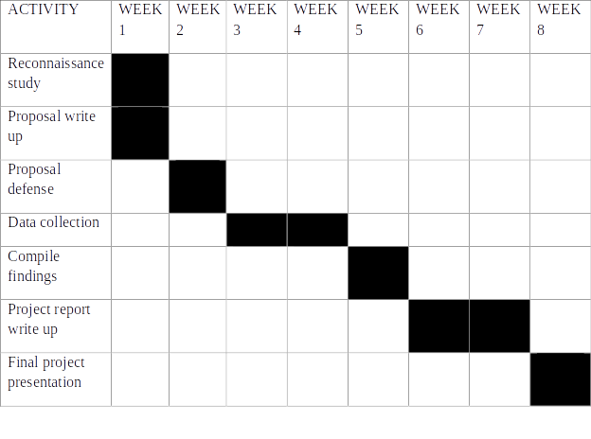
WORK PLAN

Slide 18
BUDGET
ACTIVITIES | COST
QUESTIONNAIRES PRINT OUTS | 2300
TRANSPORT | 3000
FOOD | 3000
DATA COLLECTION | 2200
DATA ANALYSIS | 1000
TOTAL = KSH 11,500

Slide 19

THANK YOU!

